Slide 1
Raspberry Pi Embedded Application in C++
Image capture, motion detection, and Mms messages
By: braden Roberts and Katrina Mehring

Slide 2
Overview:
What is an Embedded Application?
What is a Raspberry Pi?
Definition
Hardware
How it runs
Our Project

Slide 3
What is an Embedded Application?
Embedded: part of a complete device
Includes hardware and mechanical parts
According to Internet of Things Agenda:
“combination of computer hardware and software”
“fixed in capability or programmable”
“designed for a particular function”
Loaded into program memory vs RAM

Slide 4
What is an Embedded Application? (cont’d)
Properties:
Low power consumption
Small size
Rugged operating ranges
Low per-unit cost
Limited processing resources

Slide 5
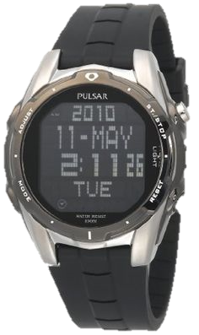
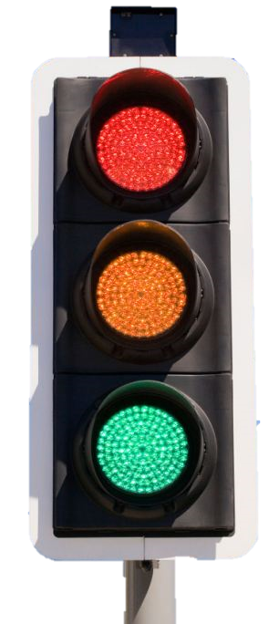
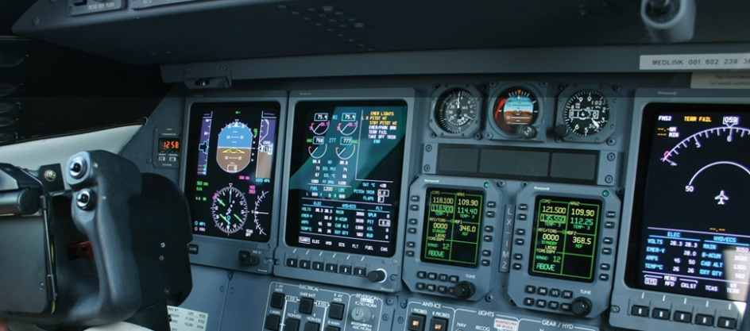
What is an Embedded Application? (cont’d)
Examples of Embedded Systems
Raspberry Pi
Arduino
Digital Watches & MP3 Players
Traffic lights
Hybrid Vehicles
Avionics

Slide 6
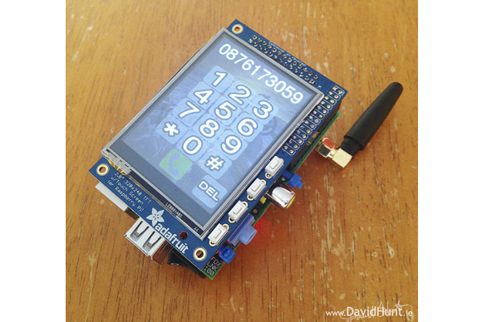
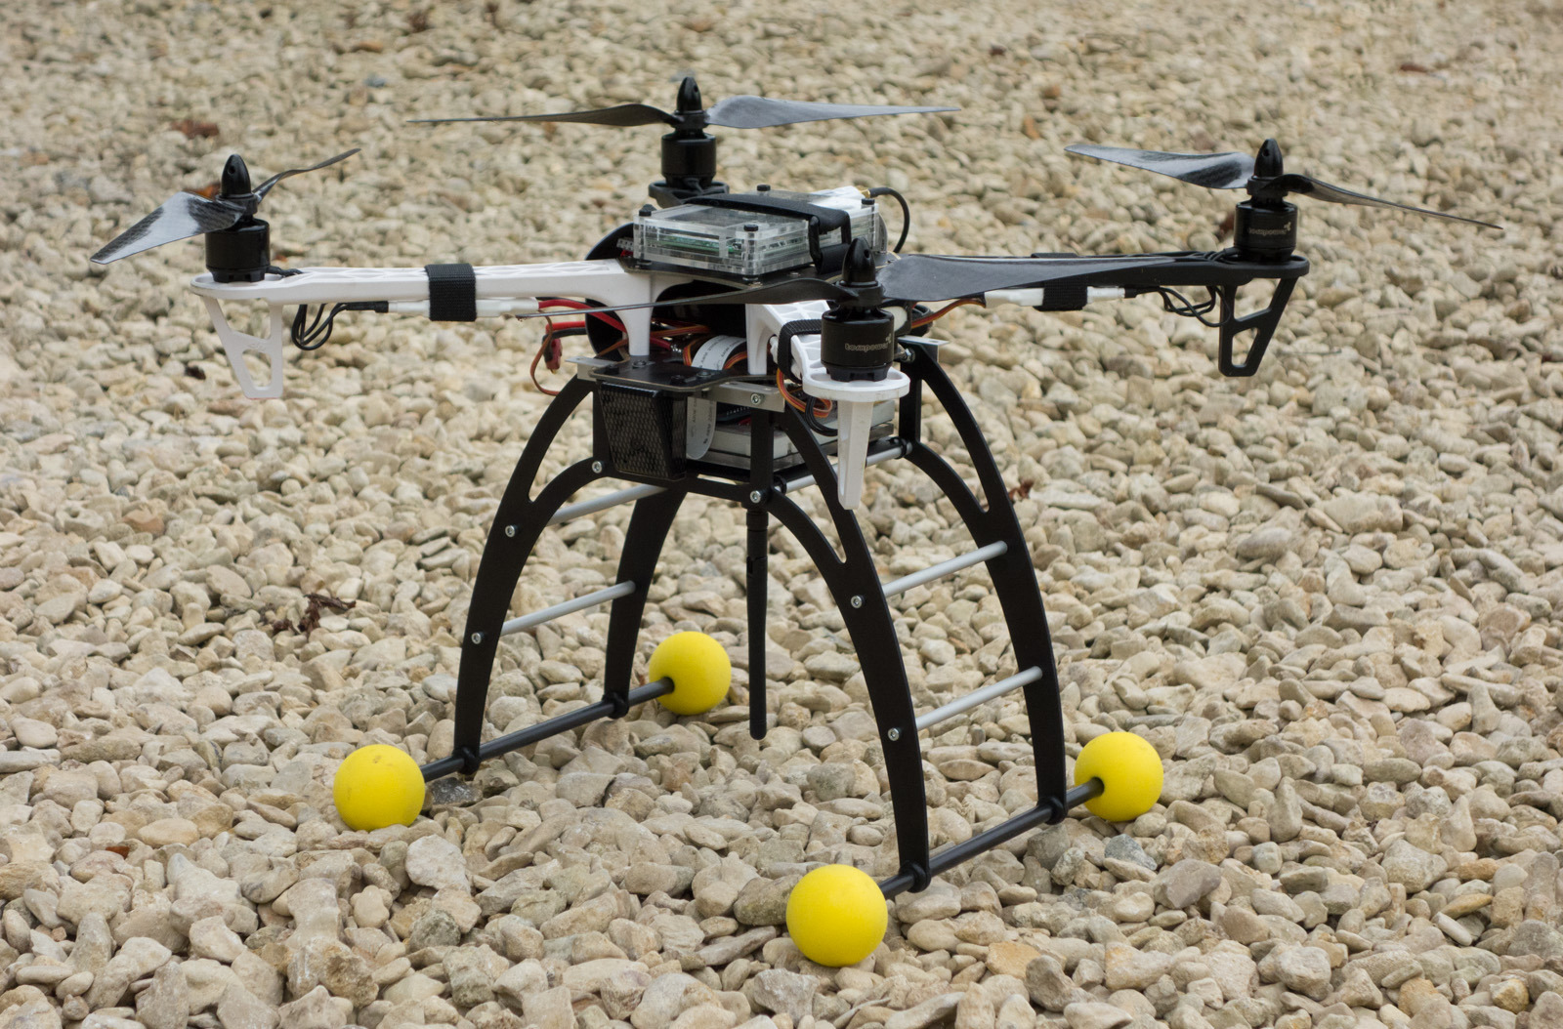
What is a Raspberry Pi - Definition
From raspberrypi.org:
“a credit card-size computer that plugs into your TV and keyboard”
85.6 mm x 56mm x 21mm
Many different models:
PI 2 Model B, Pi 3 Model B, Pi Zero, Pi 1 Model B+ and A+
A+ is the low-cost variant of the Pi
Each model varies in specs

Slide 7
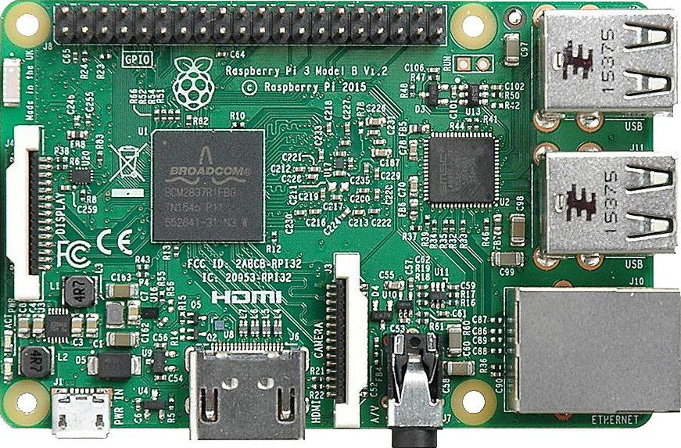
What is a Raspberry Pi - Hardware
40 pin GPIO header
4 USB ports
Uses SoC (System on a Chip) method
All necessary electronics on a single chip
Processor
Display port
Micro USB power source
Camera port
Ethernet port
HDMI output port
Audio port

Slide 8
Our Project
Overview:
Image Capture triggered by Motion Detection
Hardware required
Libraries Required
Sends the image to an email/phone
Expectations
Reality
Demo

Slide 9
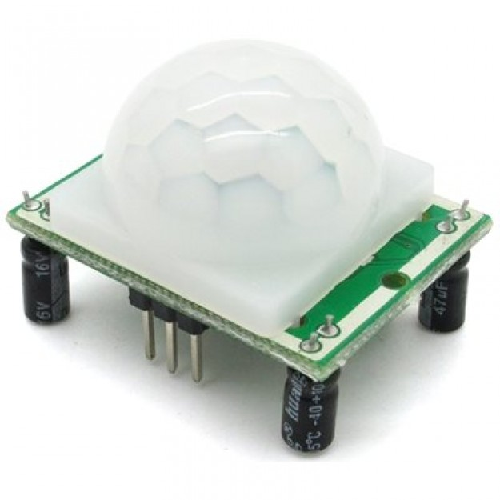
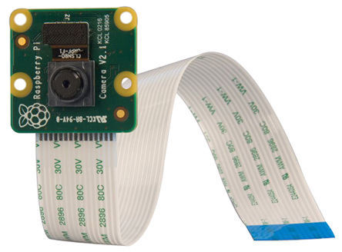
Our Project - Image Capture triggered by Motion Detection
Hardware required
Raspberry Pi
Board
Case
Power adapter
Compatible PIR Sensor
Compatible Camera Module
Ethernet cable
Wi-Fi built into new raspberry pi boards

Slide 10
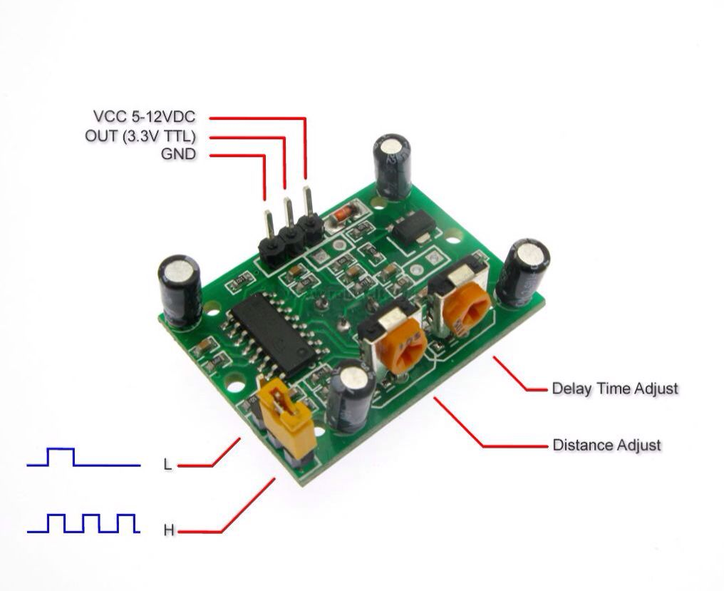
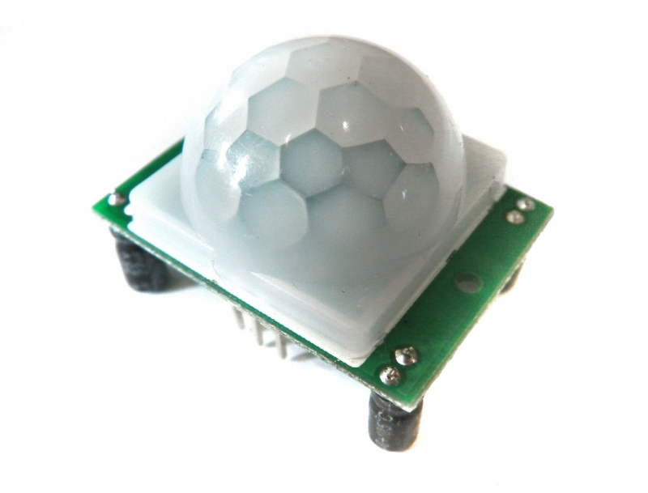
Our Project - Image Capture triggered by Motion Detection PIR (Pyroelectric InfraRed) Sensor

Slide 11
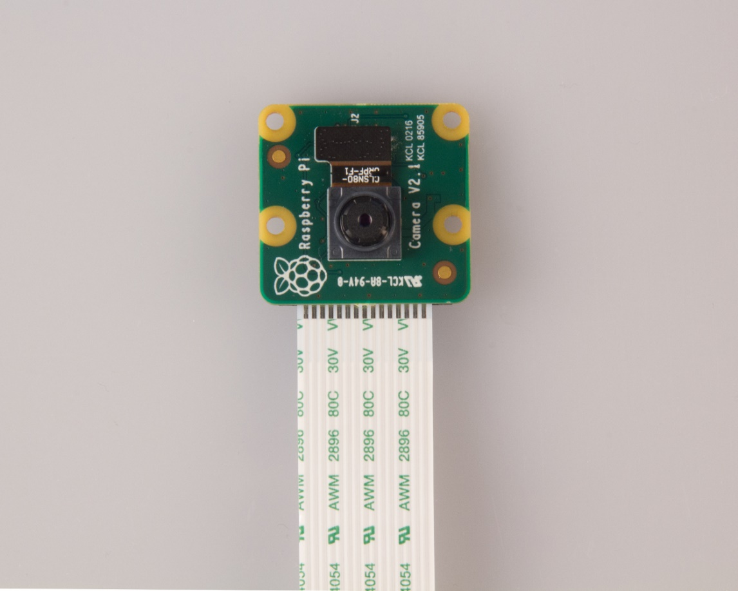
Our Project - Image Capture triggered by Motion Detection
Camera Module
5 Megapixel
Still picture resolution of 2592 x 1944
Max video resolution of 1080p
Max frame rate of 30fps

Slide 12
Required Libraries
Cstdlib
Used for the “system()” Command
WiringPi
C++ library designed to interface with hardware on the Raspberry Pi.
wiringPiSetup() – call at beginning of program to initialize the device
pinMode(0,INPUT) - setup Pin 0 as an input pin
digitalRead(0) – reads the current value of pin 0
Needs to be compiled with -lwiringPi

Slide 13
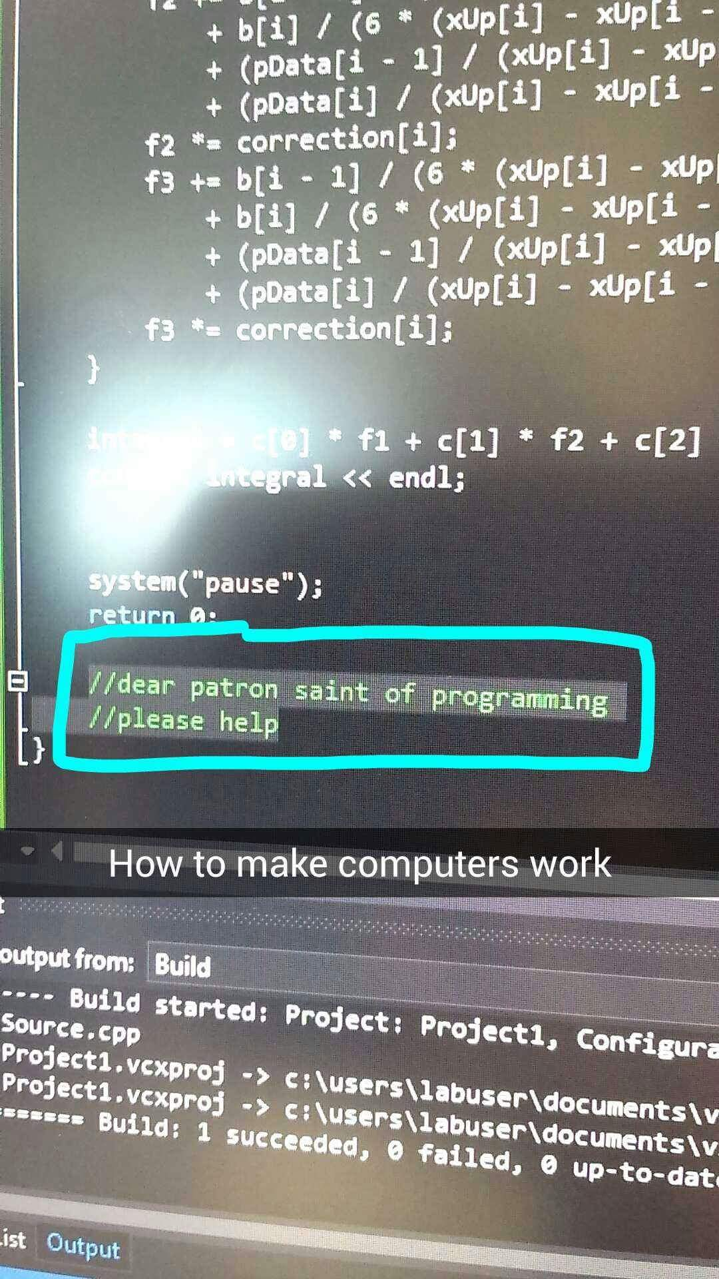
Our Project - Sending Image to Email/Phone
Expectations:
Set up web server that will send out text messages
#include a bunch of libraries
Follow very vague tutorials
Search Stack Overflow for hours
Make sacrifices to the Patron Saints
Photo Credit: Silvia Smith USU

Slide 14
Our Project - Sending Image to Email/Phone
Reality:
Googled “send images C++” – complicated servers and libraries
Googled “send mms C++” – complicated libraries
Googled “send images via command line” – send sms via command line
Google “send mms from Raspberry Pi” – send images from Unix terminal
FacePalm
Installed command line tools via apt-get
#include <cstdlib>
Called “system” command

Slide 15
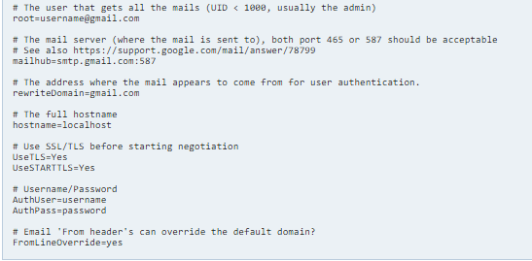
Our Project - Sending Image to Email/Phone
Reality (cont’d)
ssmtp tool
Allows sending emails/texts from Gmail Server
Setup ssmtp.conf file
Allow access to Unsecure Apps
mutt
Uses ssmtp
Used to attach files
-s subject -a attachment tags
echo
Creates a message to be sent
Had to send to vzpix, not vtext

Slide 16
Problems we ran into - (Can’t Have your Pi and Eat it Too)
Connecting to Internet
Connecting to the Pi through an Ethernet connection
Trying to do both at the same time
Display while connected to Internet
Finding the tools to send the image

Slide 17
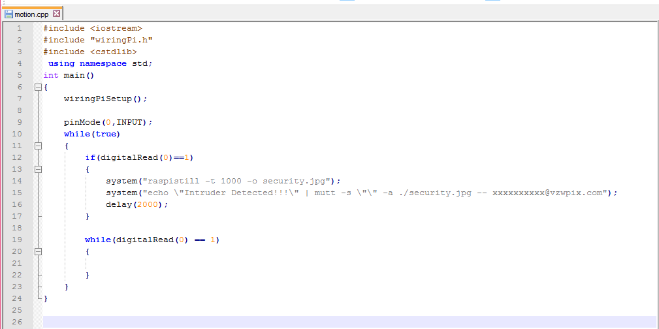
Source Code

Slide 18
Demo!!

Slide 19
References:
http://internetofthingsagenda.techtarget.com/definition/embedded-system
https://en.wikipedia.org/wiki/Embedded_system
https://www.raspberrypi.org/
https://wiki.archlinux.org/index.php/SSMTP
Photo from Silvia Smith USU

